Slide 1
Store data in and retrieve
data from collections
Gulnaz Zhomartkyzy
D. Serikbayev EKSTU

Slide 2
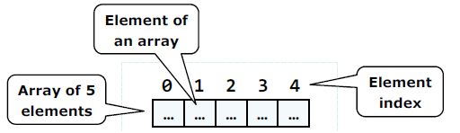
WORKING WITH DATA COLLECTIONS
Arrays
All arrays inherit from the base class System.Array.
The two most commonly used properties of an array are –
Length and Rank.
The Rank property - indicates the number of dimension in the array. These properties are helpful when determining the bounds of an array when doing for or while loops.
The Clone - method is used to make a shallow copy of the array, while the CopyTo method copies the elements of the array to another array.

Slide 3
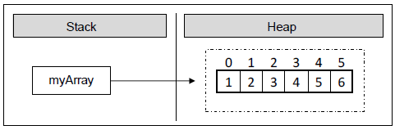
Arrays
An array is the most basic type used to store a set of data. An array contains elements, and they are referenced by their index using square brackets, [].
The following example creates a single dimensional array of integers:
int[] myArray = new int[6];
myArray[0] = 1;
myArray[1] = 2;
myArray[2] = 3;
myArray[3] = 4;
myArray[4] = 5;
myArray[5] = 6;

Slide 4
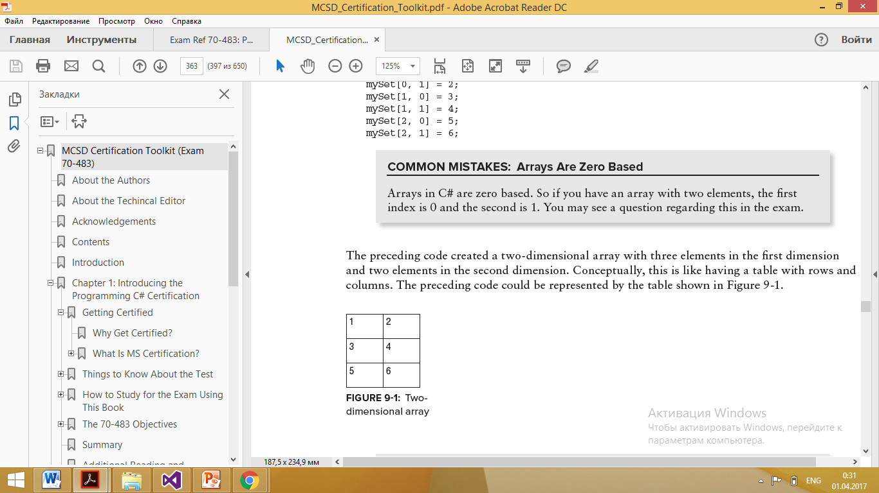
Two-dimensional array
int[,] mySet2 = new int[3, 2];
mySet2[0, 0] = 1;
mySet2[0, 1] = 2;
mySet2[1, 0] = 3;
mySet2[1, 1] = 4;
mySet2[2, 0] = 5;
mySet2[2, 1] = 6;
Two-dimensional array

Slide 5
Collections
Collections is a generic term for special classes in C# that are more flexible than arrays. These classes enable you to dynamically add or subtract elements after they have been initialized, associate keys for elements, automatically sort the elements, and allows for elements to be different types or type specific.
Some of the classes are List, List<T>, Dictionary, Dictionary<T>, Stack, and Queue. These classes all have slightly different functionality and are explained in detail in next few sections.
The namespaces for the collection classes are System.Collections, System.Collections.Generic

Slide 6
System.Collections
The System.Collections namespace contains classes for use when you do not have the same type of elements stored within the collection. These collections can mix int, string, classes, or structs within the same collection. Table 9-2 lists the types in the System.Collections namespace. Each of these types is discussed in more detail in the following sections.

Slide 7
System.Collections
Table1 – lists the types in the System.Collections namespace
COLLECTION NAME | DESCRIPTION
ArrayList | Creates a collection whose size is dynamic and can contain any type of object
HashTable | Creates a collection with a key\value pair whose size is dynamic and contains any type of object
Queue | Creates a collection that is first-in-first-out for processing
SortedList | Creates a collection of key\value pairs whose elements are sorted by the key value
Stack | Creates a collection that is last-in-first-out for processing

Slide 8
ArrayList
An ArrayList is a class that enables you to dynamically add or remove elements to the array. This is different from the simple array, which does not enable you to change the dimensions after it is initialized. The ArrayList class is useful when you don’t know the number of elements at the time of creation and also if you want to store different types of data in the array. In the Array examples, all elements of the mySet array had to be an int. An ArrayList has an Add method that takes an object as a parameter and enables you to store any type of object. The following code creates an ArrayList object and adds three elements of different types to the ArrayList:
ArrayList myList = new ArrayList();
myList.Add(1);
myList.Add("hello world");
myList.Add(new DateTime(2012, 01, 01));

Slide 9
ArrayList
TABLE 2 : Common System Array Properties
PROPERTY | DESCRIPTION
Capacity | Gets or sets the number of elements in the ArrayList
Count | Gets the number of actual elements in the ArrayList
Item | Gets or sets the element at the specified index

Slide 10
ArrayList
TABLE 3: Common System Array Methods
METhOD | DESCRIPTION
Add | Adds an element at the end of the ArrayList
AddRange | Adds multiple elements at the end of the ArrayList
BinarySearch | Searches the sorted ArrayList for an element using the default com-parer and returns the index of the element
Clear | Removes all the elements from the ArrayList
Contains | Determines if an element is in the ArrayList
CopyTo | Copies the ArrayList to a compatible one-dimensional array
IndexOf | Searches the ArrayList and returns the index of the first occurrence within the ArrayList

Slide 11
ArrayList
TABLE 3: Common System Array Methods
METHOD | DESCRIPTION
Insert | Inserts an element into the ArrayList at a specific index
Remove | ARemoves an element from the ArrayList
RemoveAt | Removes an element from the ArrayList by index
Reverse | Reverses the order of the elements in the ArrayList
Sort | Sort the elements in the ArrayList

Slide 12
ArrayList
Example for a simple sorting exercise:
ArrayList myList = new ArrayList();
myList.Add(4);
myList.Add(1);
myList.Add(5);
myList.Add(3);
myList.Add(2);
myList.Sort();
foreach (int i in myList)
{
Console.WriteLine(i.ToString());
}

Slide 13
ArrayList
class MyObject
{
public int ID { get; set; }
}
ArrayList myList = new ArrayList();
myList.Add(new MyObject() { ID = 4 });
myList.Add(new MyObject() { ID = 1 });
myList.Add(new MyObject() { ID = 5 });
myList.Add(new MyObject() { ID = 3 });
myList.Add(new MyObject() { ID = 2 });
myList.Sort();
foreach (MyObject i in myList)
{
Console.WriteLine(i.ID.ToString());
}

Slide 14
ArrayList
class MyObject : IComparable
{ public int ID { get; set; }
public int CompareTo(object obj)
{ MyObject obj1 = obj as MyObject;
return this.ID.CompareTo(obj1.ID);
}
}
ArrayList myList = new ArrayList();
myList.Add(new MyObject() { ID = 4 });
myList.Add(new MyObject() { ID = 1 });
myList.Add(new MyObject() { ID = 5 });
myList.Add(new MyObject() { ID = 3 });
myList.Add(new MyObject() { ID = 2 });
myList.Sort();
foreach (MyObject i in myList)
{
Console.WriteLine(i.ID.ToString());
}

Slide 15
ArrayList
ArrayList myList = new ArrayList();
myList.Add(new MyObject() { ID = 4 });
myList.Add(new MyObject() { ID = 1 });
myList.Add(new MyObject() { ID = 5 });
myList.Add(new MyObject() { ID = 3 });
myList.Add(new MyObject() { ID = 2 });
myList.Sort();
int foundIndex = myList.BinarySearch(new MyObject() { ID = 4 });
if (foundIndex >= 0)
{
Console.WriteLine(((MyObject)myList[foundIndex]).ID.ToString());
}
else
{ Console.WriteLine("Element not found"); }
The ability to search the array

Slide 16
Hashtable
A Hashtable enables you to store a key\value pair of any type of object. The data is stored accord-ing to the hash code of the key and can be accessed by the key rather than the index of the element. The following sample creates a Hashtable and stores three elements with different keys. You can then reference the elements in the Hashtable by its key.
Hashtable myHashtable = new Hashtable();
myHashtable.Add(1, "one");
myHashtable.Add("two", 2);
myHashtable.Add(3, "three");
Console.WriteLine(myHashtable[1].ToString());
Console.WriteLine(myHashtable["two"].ToString());
Console.WriteLine(myHashtable[3].ToString());
The preceding code will produce the following output:
one
2
three

Slide 17

Queue
A Queue is a first-in-first-out collection. Queues can be useful when you need to store data in a specific order for sequential processing. The following code will create a Queue, add three elements, remove each element, and print its value to the Output window:
Queue myQueue = new Queue();
myQueue.Enqueue("first");
myQueue.Enqueue("second");
myQueue.Enqueue("third");
int count = myQueue.Count;
for (int i = 0; i < count; i++)
{
Console.WriteLine(myQueue.Dequeue());
}
- adds an element to the end of the Queue
- removes the oldest element from the Queue
The preceding code produces the following output:

Slide 18
SortedList
A SortedList is a collection that contains key\value pairs but it is different from a Hashtable because it can be referenced by the key or the index and because it is sorted. The elements in the SortedList are sorted by the IComparable implementation of the key or the IComparer implementation when the SortedList is created. The following code creates a SortedList, adds three elements to the list, and then prints the elements to the Output window:
SortedList mySortedList = new SortedList();
mySortedList.Add(3, "three");
mySortedList.Add(2, "second");
mySortedList.Add(1, "first");
foreach (DictionaryEntry item in mySortedList)
{ Console.WriteLine(item.Value); }
The preceding code produces the following output:
first
second
third

Slide 19
Stack
A Stack collection is a last-in-first-out collection. It is similar to a Queue except that the last element added is the first element retrieved. To add an element to the stack, you use the Push method. To remove an element from the stack, you use the Pop method.
The following code creates a Stack object, adds three elements, and then removes each element and prints the value to the Output window:
Stack myStack = new Stack();
myStack.Push("first");
myStack.Push("second");
myStack.Push("third");
count = myStack.Count;
for (int i = 0; i < count; i++)
{ Console.WriteLine(myStack.Pop()); }
The preceding code produces the following output:
third
second
first

Slide 20
System.Collections.Generic
The System.Collections.Generic namespace contains classes that are used when you know the type of data to be stored in the collection and you want all elements in the collection to be of the same type. Table 9-5 lists the types in the System.Collections.Generic namespace. These types are described in detail in the following sections.
Use Generic Type Whenever Possible
It is considered best practice to use a collection from the Generic namespace because they provide type-safety along with performance gains compared to the non-generic collections.

Slide 21
System.Collections.Generic
TABLE 4: System Collections Generic
COLLECTION NAME | DESCRIPTION
Dictionary<TKey, TValue> | Creates a collection of key\value pairs that are of the same type
List<T> | Creates a collection of objects that are all the same type
Queue<T> | Creates a first-in-first-out collection for objects that are all the same type
SortedList<TKey, TValue> | Creates a collection of key\value pairs that are sorted based on the key and must be of the same type
Stack<T> | Creates a collection of last-in-first-out object that are all of the same type

Slide 22
Dictionary
A Dictionary type enables you to store a set of elements and associate a key for each element. The key, instead of an index, is used to retrieve the element from the dictionary. This can be useful when you want to store data that comes from a table that has an Id column. You can create an object that holds the data and use the record’s Id as the key.

Slide 23
Dictionary
static void Sample2()
{
Dictionary<int, MyRecord1> myDictionary = new Dictionary<int, MyRecord1>();
myDictionary.Add(5, new MyRecord1() { ID = 5, FirstName = "Bob", LastName = "Smith" });
myDictionary.Add(2, new MyRecord1() { ID = 2, FirstName = "Jane", LastName = "Doe" });
myDictionary.Add(10, new MyRecord1() { ID = 10, FirstName = "Bill", LastName = "Jones" });
Console.WriteLine(myDictionary[5].FirstName);
Console.WriteLine(myDictionary[2].FirstName);
Console.WriteLine(myDictionary[10].FirstName);
}
The preceding code will write "Bob", "Jane", and "Bill" to the Output window.

Slide 24
Dictionary
If you want to know how many elements are in the Dictionary object, you use the Count property,
TABLE 5: Common System Collections Generic Dictionary Methods
METHOD | DESCRIPTION
Add | Adds a key and value to the dictionary
Clear | Removes all the keys and values in the dictionary
ContainsKey | Returns true if the dictionary contains the specified key
ContainsValue | Returns true if the dictionary contains the specified value
Remove | Removes the element with the specified key

Slide 25
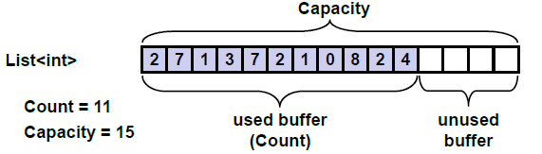
List
A List class is a strongly typed collection of objects. It is similar to an ArrayList except all elements of the List must be of the same type. It is different from a Dictionary because there is no Key, and elements are referenced by index. When you declare the List object, you specify the type of elements it can contain.
List<int> myList = new List<int>();
When you add elements to the list, they must be of that type, or you get an error. The preceding code created a List object that can contain only int values.
myList.Add(1);
myList.Add(2);
myList.Add(3);

Slide 26
Summary
Which type of collection class to use based on a specific set of requirements?
Remember the following points:
1. Generic collections are used when you have the same type for all elements.
2. Lists and ArrayLists are referenced by index and do not have a key.
3. Dictionaries, SortedLists, and Hashtables have a key\value pair.
4. Queues and Stacks are used when you have a specific order of processing.

Slide 27
Summary
The .NET Framework offers both generic (строгие коллекции) and nongeneric collections (нестрогие коллекции). When possible, you should use the generic version.
Array is the most basic type to store a number of items. It has a fixed size.
List is a collection that can grow when needed. It’s the most-used collection.
Dictionary stores and accesses items using key/value pairs.
HashSet stores unique items and offers set operations that can be used on them.
A Queue is a first-in, first-out (FIFO) collection.
A Stack is a first-in, last-out (FILO) collection.
You can create a custom collection by inheriting from a collection class or inheriting from one of the collection interfaces.

